Slide 1
Finding Hamiltonian path using DNA COMPUTING

Slide 2
DNA COMPUTING
DNA computing is a branch of computing which uses DNA, biochemistry, and molecular biology hardware, instead of the traditional silicon-based computer technologies.
This field was initially developed by Leonard Adleman of the University of Southern California, in 1994.
Adleman demonstrated a proof-of-concept use of DNA as a form of computation which solved the Hamiltonian path problem.

Slide 3
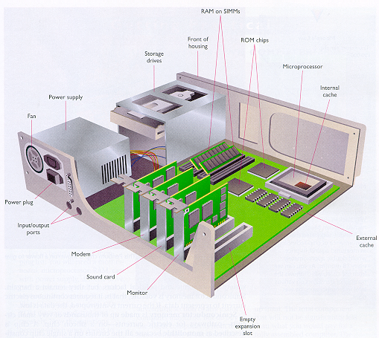
DNA COMPUTING
011001101010001
ATGCTCGAAGCT

Slide 4
Hamiltonian path
Hamiltonian path is a path in an undirected or directed graph that visits each vertex exactly once.

Slide 5
Adleman’s solution of the Hamiltonian Path Problem(HPP).
1.Generate Random paths
2.From all paths created in step 1, keep only those that start at s and end at t.
3.From all remaining paths, keep only those that visit exactly n vertices.
4.From all remaining paths, keep only those that visit each vertex at least once.
5.if any path remains, return “yes”; otherwise, return “no”.

Slide 6
Step 1.Random Path Generation.
Assumptions
Random single stranded DNA sequences with 20 nucleotides are available.
Generation of number of copies of short DNA strands is easy to do.
Vertex representation
Each vertex v in the graph is associated with a random 20-mer sequence of DNA denoted by S_{v.}.
For each such sequence obtain its complement S_{v.}
Generate many copies of each S_{v} sequence in test tube T_{1.}

Slide 7
For example, the sequences chosen to represent vertices 2,4 and 5 are the following:
S₂ = GTCACACTTCGGACTGACCT
S₄ = TGTGCTATGGGAACTCAGCG
S₅ = CACGTAAGACGGAGGAAAAA
The reverse complement of these sequences are:
S₂ = AGGTCAGTCCGAAGTGTGAC
S₄ = CGCTGAGTTCCCATAGCACA
S₅ = TTTTTCCTCCGTCTTACGTG

Slide 8
Step1. Random Path Generation.
Edge representation
For each edge u→v in the graph, S_{u→v} is created that is 3’ 10-mer of S_{u} followed by 5’ 10-mer of S_{v}
If u=s then it is all of S_{u} or if v=t then it is all of S_{v.}(i.e.each edge denoted by 20-mer while the edge that involves either s or t is a 30-mer.)
With this construction, S_{uv} = S_{vu}. (Preservation of Edge Orientation.)
Generate many copies of each S_{uv} sequence in test tube T₂

Slide 9
Edge representation
5’ S2 3’
5’ S4 3’
EDGE(2,4)
5’ S3 3’
5’ S4 3’
EDGE(3,4)

Slide 10
S₂ = GTCACACTTCGGACTGACCT
S₄ = TGTGCTATGGGAACTCAGCG
S₅ = CACGTAAGACGGAGGAAAAA
S₂ = AGGTCAGTCCGAAGTGTGAC
S₄ = CGCTGAGTTCCCATAGCACA
S₅ = TTTTTCCTCCGTCTTACGTG
So,we build edges (2,4) and (4,5) from the above sequences obtaining them in the following manner:
(2,4) = GGACTGACCTTGTGCTATGG
(4,5) = GAACTCAGCGCACGTAAGAC

Slide 11
Step1.Random Path Generation
Path Construction
Pour T1 and T2 into T3.
In T3 many ligase reactions will take place.
(Ligase Reaction or ligation: There is an enzyme called Ligase, that causes concatenation of two sequences in a unique strand.)

Slide 12
Step1.Random Path Generation
By executing these 3 operations,we get many random paths for the following reasons:
Consider S_{u},S_{v},S_{w},S_{uv},S_{vw} for u,v,w distinct vertices.
10 base suffix of one S_{u} sequence will bind to the 10 base prefix of one S_{uv} sequence. (one is complement of the other.)
At the same time 10-base suffix of same sequence S_{uv} binds to the 10-base prefix of one S_{v} sequence
S_{v} 10-base suffix binds to the 10-base prefix of one S_{vw} sequence.
The final double strand thus obtained encodes (u,v,w) in G.

Slide 13
Step 2 “keep only those that start at s and end at t.”
Product of step 1 was amplified by PCR (Polymerase Chain Reaction) using primers S_{s} and S_{t}.
By this, only those molecules encoding paths that begin with vertex s and end with vertex t were amplified.

Slide 14
Polymerase Chain Reaction - PCR
PCR amplifies DNA
Makes lots of copies of a few copies of DNA
Can copy different lengths of DNA, doesn’t have to copy the whole length of a DNA molecule
One gene
Several genes
Lots of genes
Bind each primer to its appropriate strand
One primer binds to the 5’ end of one of the DNA strands
The other primer binds to the 3’ end of the anti-parallel DNA strand
Select the region of DNA you want amplified
Copy each strand

Slide 15
Step 3 “keep only those that visit exactly n vertices”
Product of step 2 is run on agarose gel and the 140bp (since 7 vertices) band was kept.
Agarose gel electrophoresis method is used in step3

Slide 16
Gel Electrophoresis of DNA
Gel electrophoresis detects the presence of DNA in a sample
Gel electrophoresis detects the number of nucleotides in a fragment of DNA
e.g., the number of nucleotides in a DNA region which was amplified by PCR
Is a rough estimate, is not exact, need more sophisticated sequencing techniques to get an exact number of nucleotides

Slide 17
Gel Electrophoresis of DNA
A sample which contains fragments of DNA is forced by an electrical current through a firm gel which is really a sieve with small holes of a fixed size
Phosphate group in DNA is negatively charged so it is moved towards a positive electrode by the current
Longer fragments have more nucleotides
So have a larger molecular weight
So are bigger in size
So aren’t able to pass through the small holes in the gel and get hung up at the beginning of the gel
Shorter fragments are able to pass through and move farther along the gel
Fragments of intermediate length travel to about the middle of the gel.
The number of nucleotides are then estimated by comparing it to a known sample of DNA fragments which is run through the gel at the same time

Slide 18
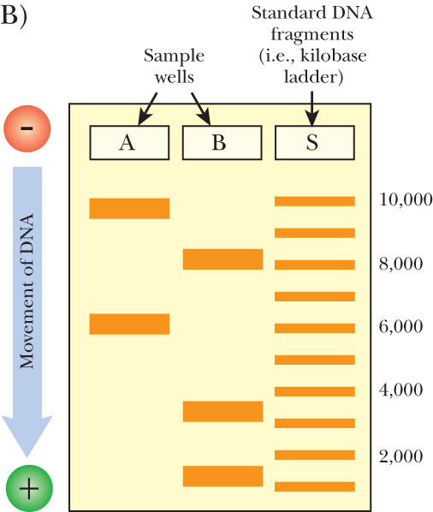
Gel Electrophoresis of DNA

Slide 19
Step 3 “keep only those that visit exactly n vertices”
DNA is negatively charged.
Place DNA in a gel matrix at the negative end. (Gel Electrophoresis)
Longer strands will not go as far as the shorter strands.
In our example we want DNA that is 7 vertice times 20 base pairs, or 140 base pairs long.

Slide 20
Step 4 “keep only those that visit each vertex at least once”
From the double stranded DNA product of step3, generate single stranded DNA.
Incubate the single stranded DNA with S₂ conjugated to the magnetic beads.
Only single stranded DNA molecules that contained the sequence S₂ annealed to the bound S₂ and were retained
Process is repeated successively with S₄,S₆,S₃,S₅

Slide 21
Step 5:Obtaining the Answer
Conduct a “graduated PCR” using a series of PCR amplifications.
Use primers for the start, s and the n^{th} item in the path.
So to find where vertex 4 lies in the path you would conduct a PCR using the primers from vertex s and vertex 4.
You would get a length of 60 base pairs.
60 / 20 nucleotides in the path = 3rd vertex.

Slide 22
Recap of HDPP
1. Generate random paths through graph G. (Annealing and Ligation)
2. Select paths that begin with V_{in} and terminate with V_{out}. (PCR with selected primers)
3. From step 2, select those paths with exactly n vertices. (Gel purification)
4. From step 3, select those paths that contain every vertex. (Magnetic bead purification)
5. If any paths exist from step 4, then there exists a Hamiltonian path. (PCR)

Slide 23
THANK YOU

